Slide 1


HELLO WORLD!
LIBRARYHUB
PRESENTED BY THAPANA THUNGKAM (65311347)

Slide 2
Data Dictionary (Rental)
# | Attribute | DataType | Constraint | Example Value
1 | id | INTEGER | Primary Kay | 1
2 | rentalDate | DATETIME |  | 2024-10-11 00:00:00:00 +00:00
3 | returnDate | DATETIME |  | 2024-10-14 00:00:00:00 +00:00
4 | status | VARCHAR |  | Borrowing
5 | userId | INTEGER |  | 1
6 | bookIsbn | VARCHAR |  | 4
7 | createdAt | DATETIME |  | 2024-10-10 16:42:57.342 +00:00
8 | updatedAt | DATETIME |  | 2024-10-10 16:42:57.342 +00:00

Slide 3
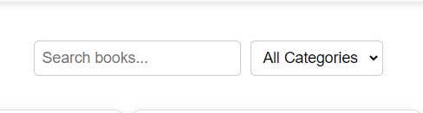
ส่วนที่เพิ่มเติม
Search Bar(การค้นหา)
PRESENTED BY THAPANA THUNGKAM (65311347)

Slide 4
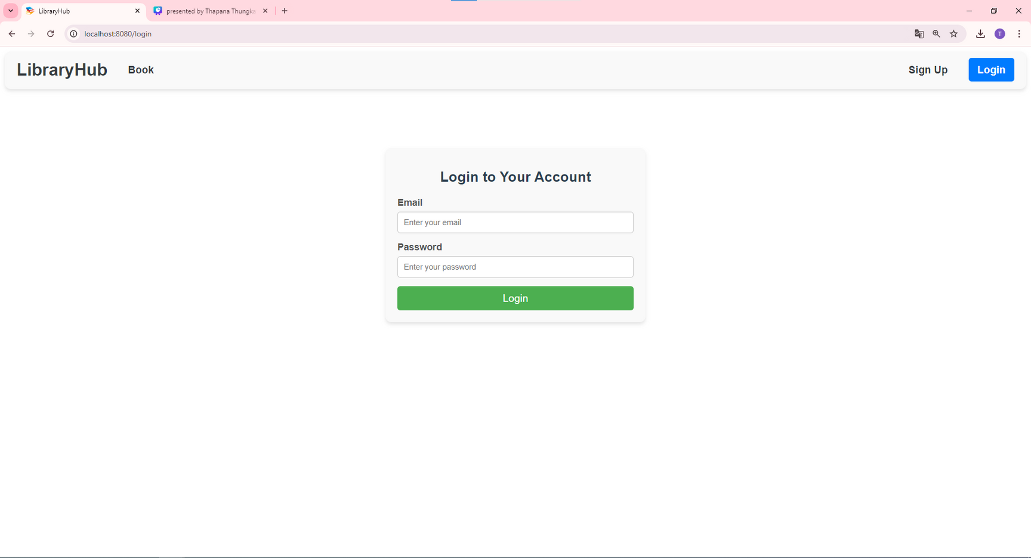
Login
PRESENTED BY THAPANA THUNGKAM (65311347)

Slide 5
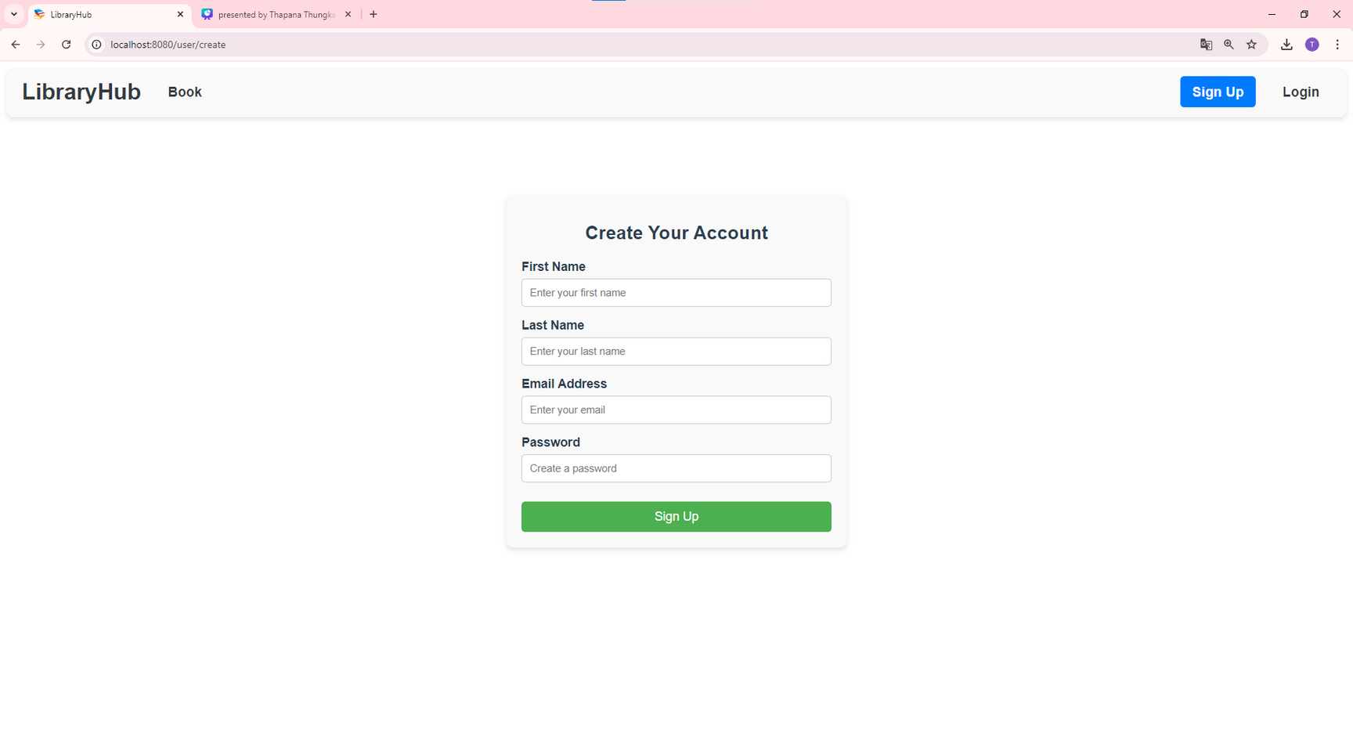
Sugn Up
PRESENTED BY THAPANA THUNGKAM (65311347)

Slide 6
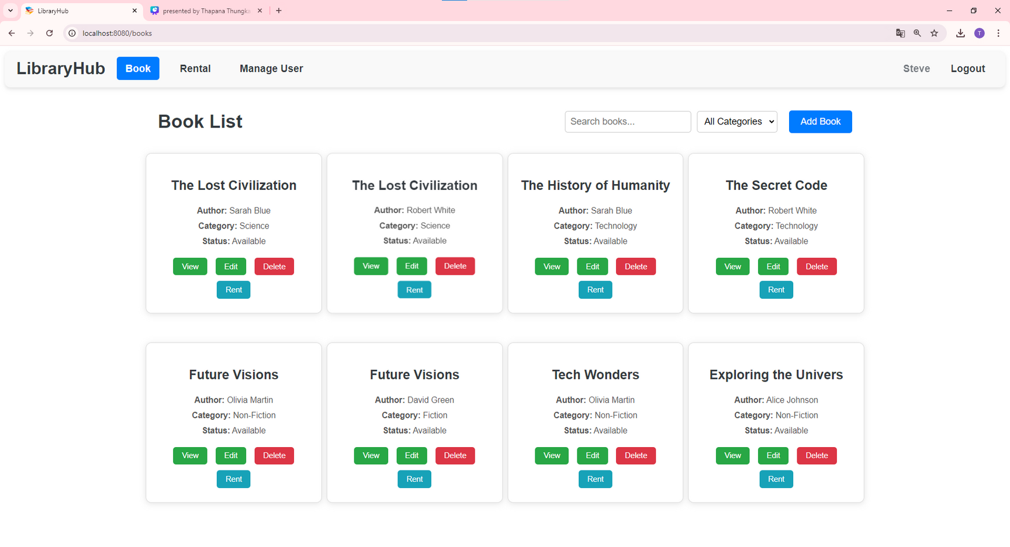
Book
PRESENTED BY THAPANA THUNGKAM (65311347)

Slide 7
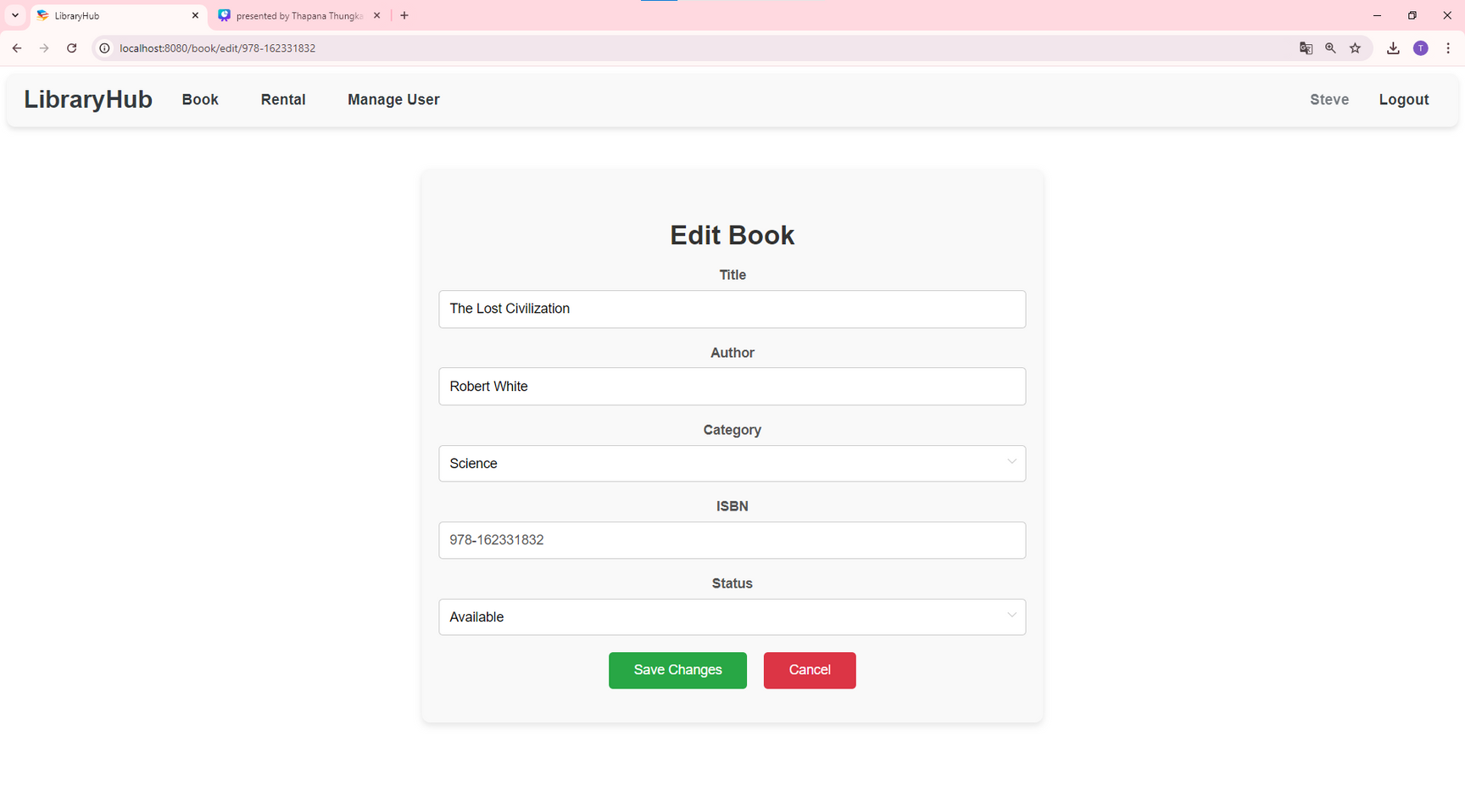
EditBook
PRESENTED BY THAPANA THUNGKAM (65311347)

Slide 8
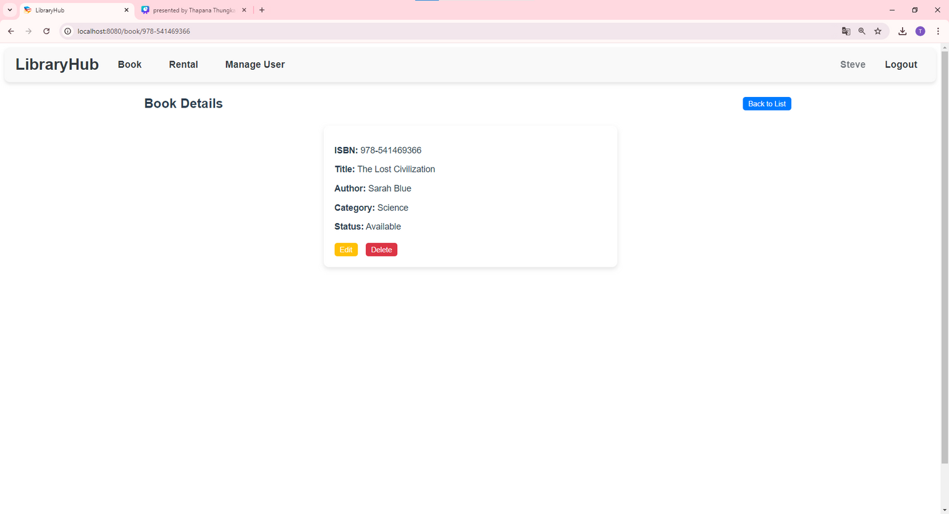
ShowBook
PRESENTED BY THAPANA THUNGKAM (65311347)

Slide 9
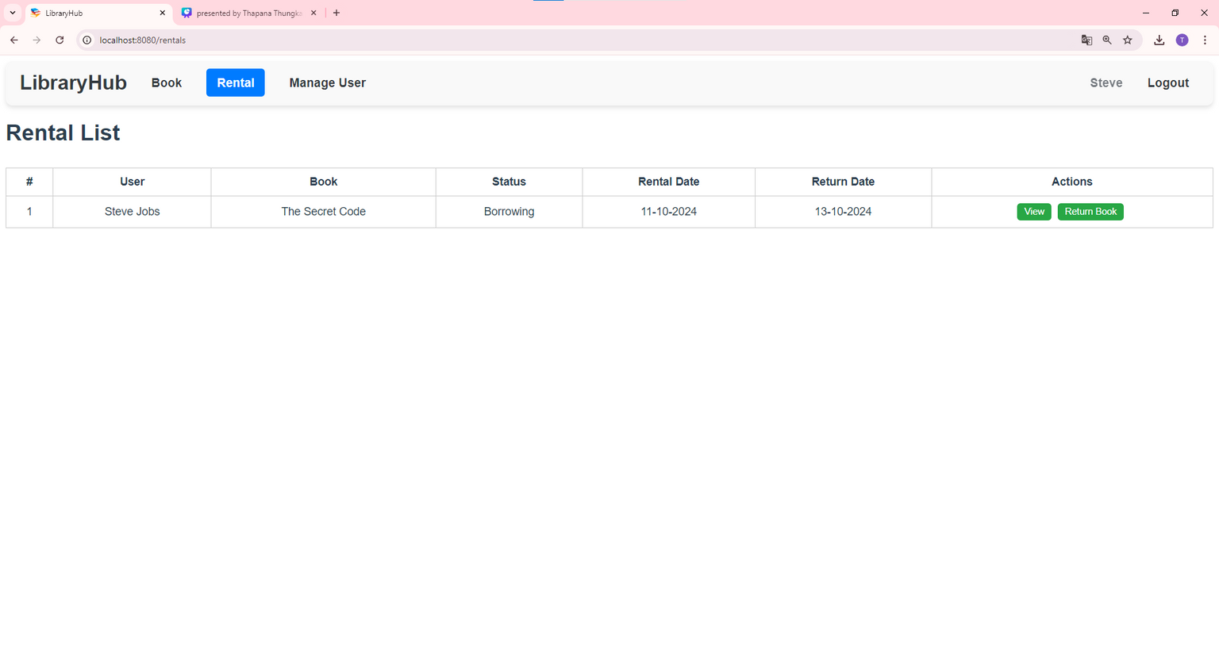
Rentals
PRESENTED BY THAPANA THUNGKAM (65311347)

Slide 10
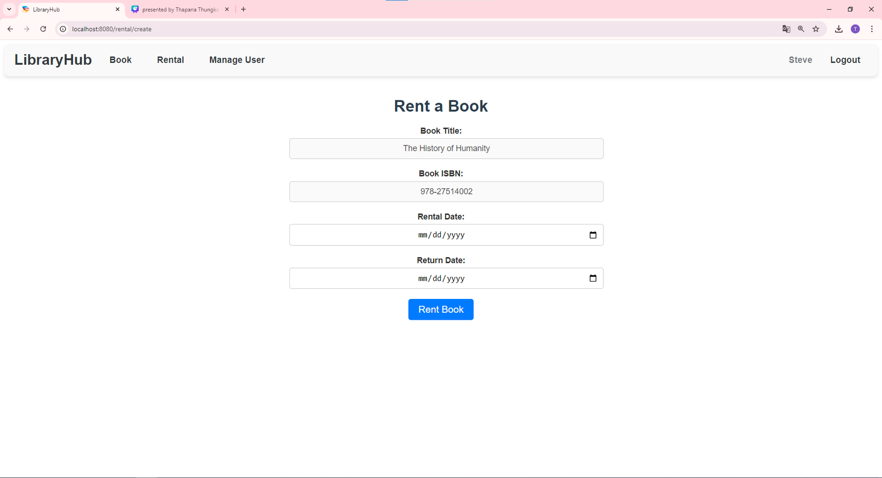
CreateRental
PRESENTED BY THAPANA THUNGKAM (65311347)

Slide 11
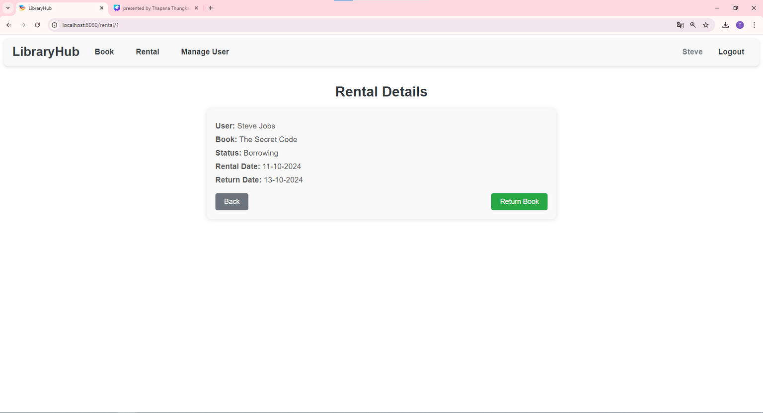
ShowRental
PRESENTED BY THAPANA THUNGKAM (65311347)

Slide 12
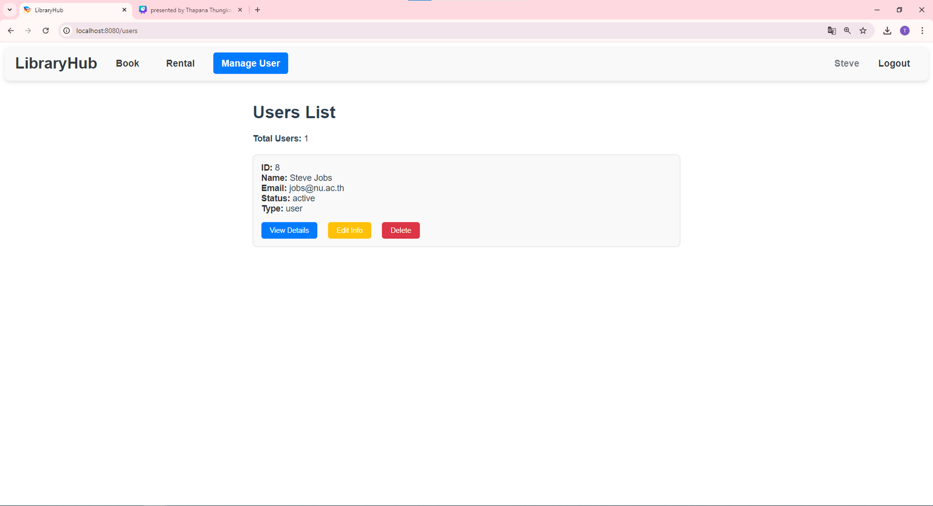
Users
PRESENTED BY THAPANA THUNGKAM (65311347)

Slide 13
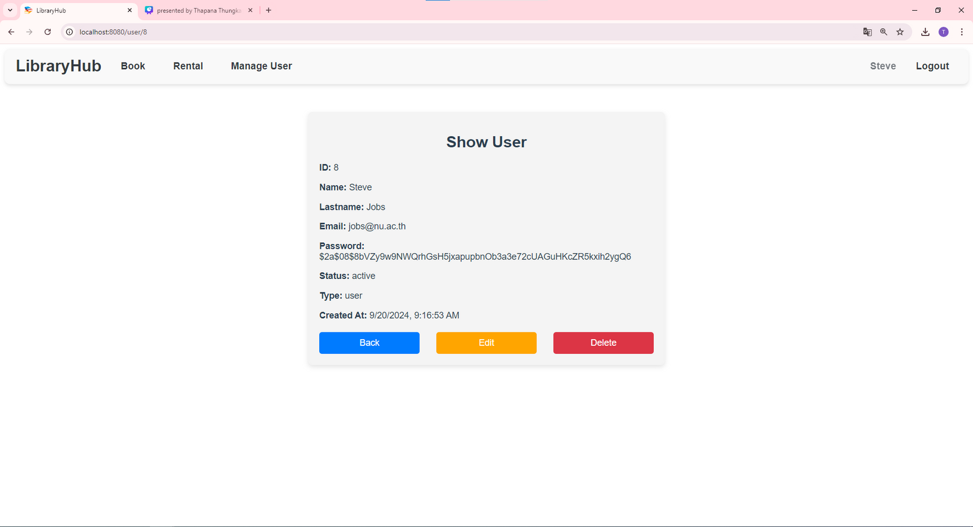
ShowUser
PRESENTED BY THAPANA THUNGKAM (65311347)

Slide 14
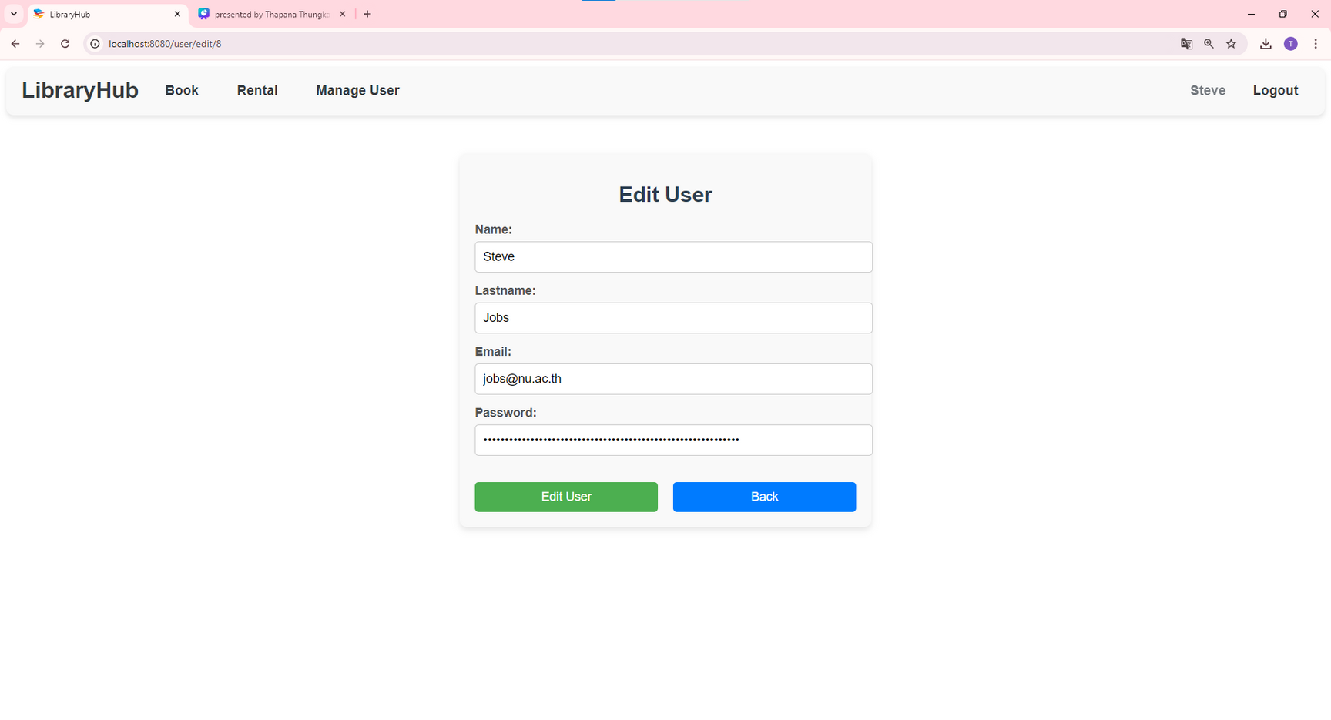
EditUser
PRESENTED BY THAPANA THUNGKAM (65311347)

Slide 15
THAPANA THUNGKAM 65311347
THANK YOU AND STAY CONNECTED

